Slide 1

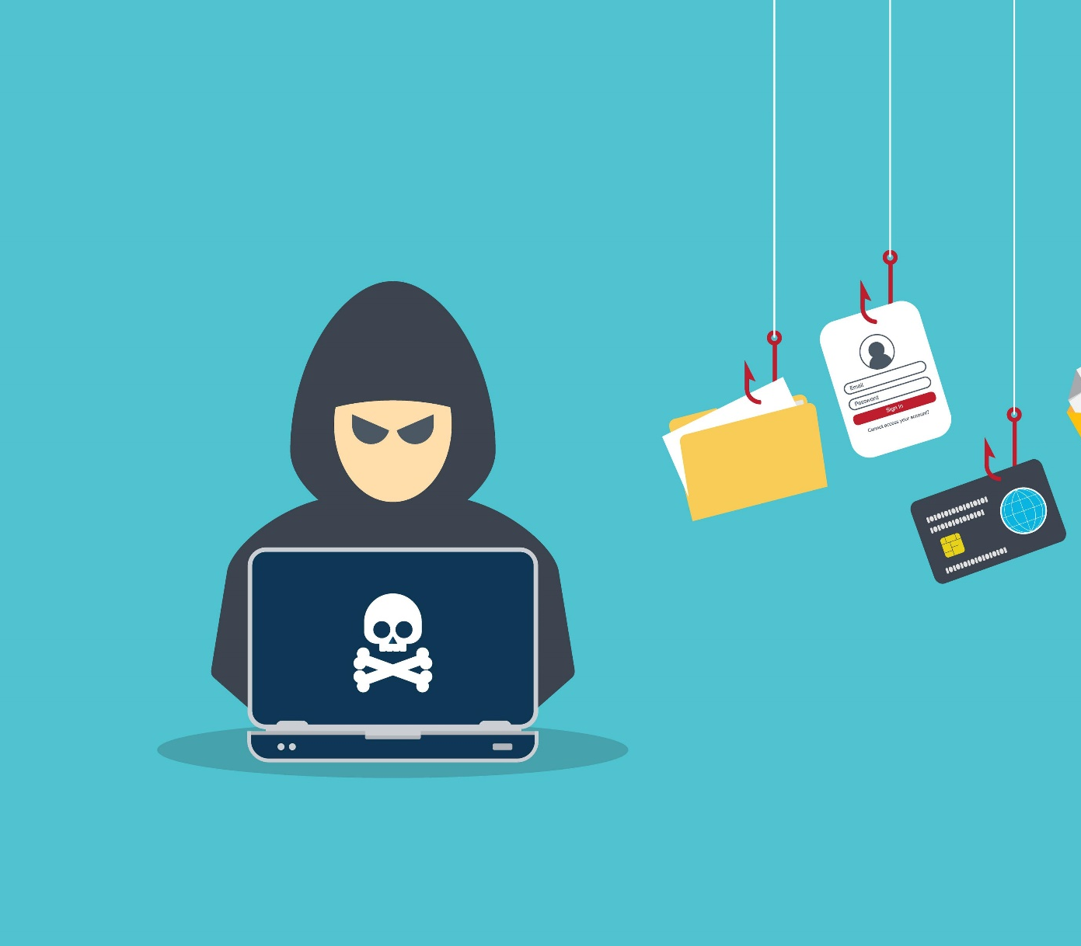
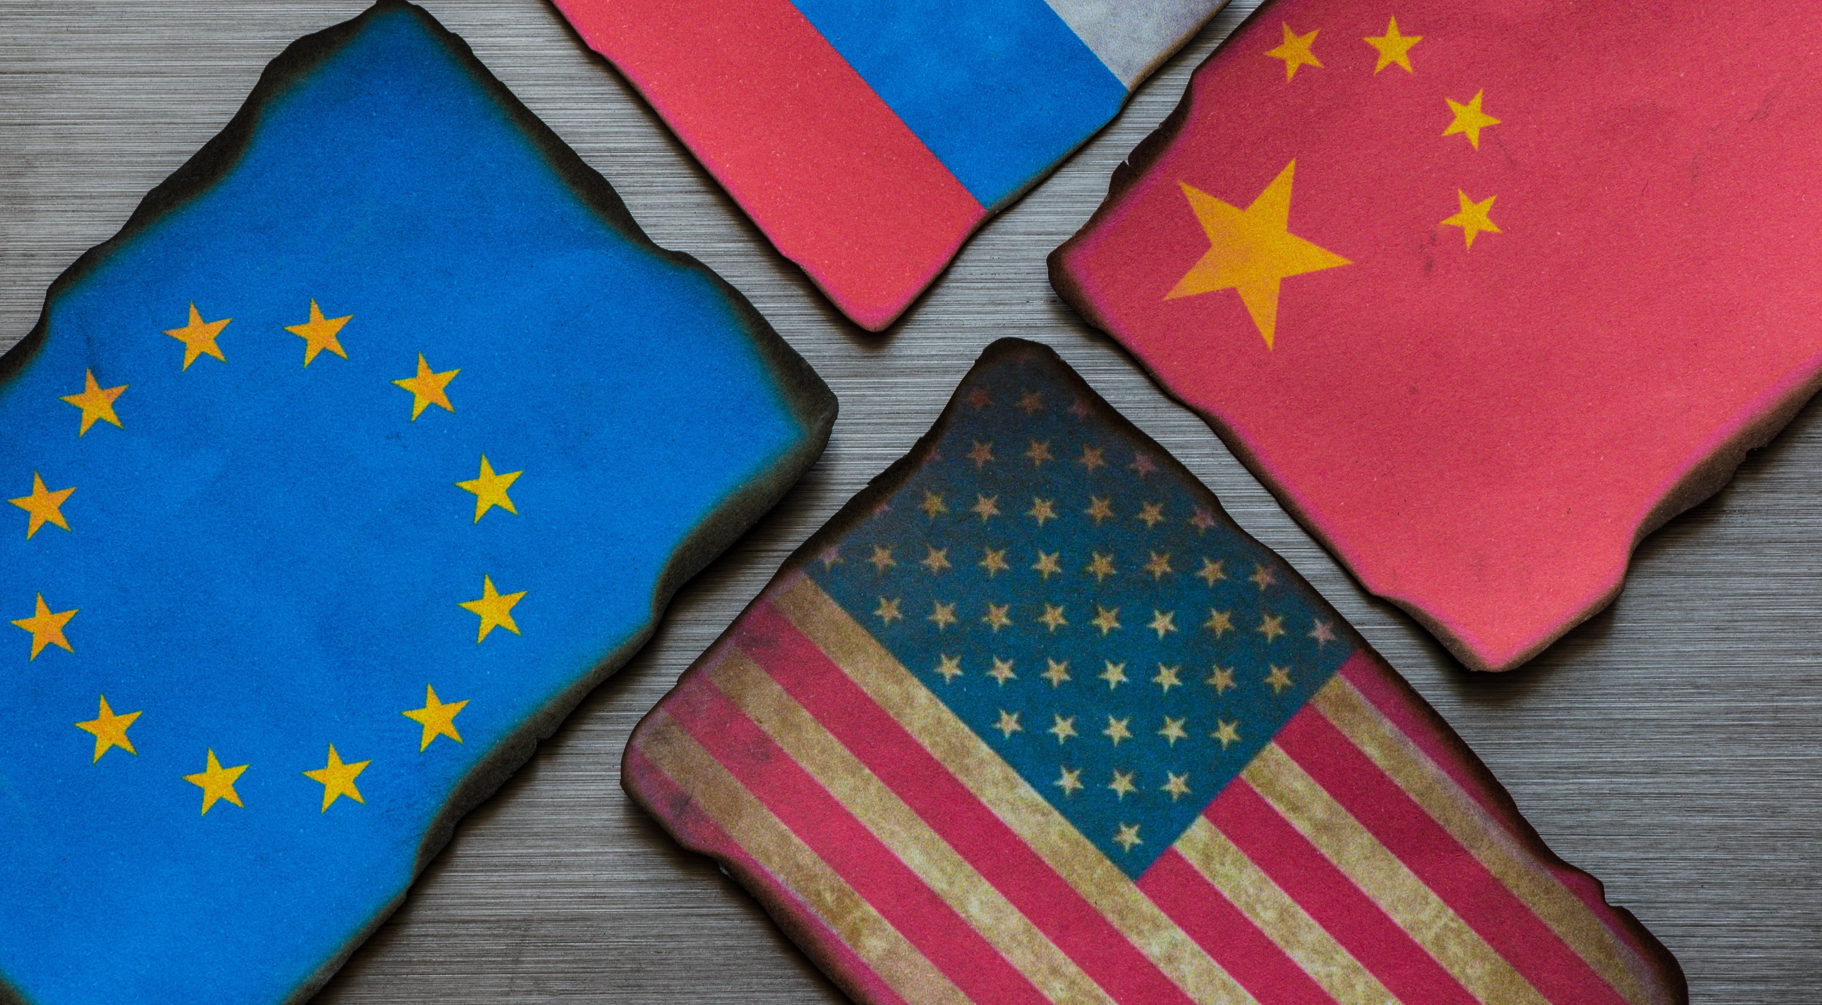
Operation
Cyber Storm
A Simulation Exercise

Slide 2


Your Host
Robert Burton
Managing Director / Co-Founder of The International Crisis Management Conference
Specialties: Developing and delivering corporate war games, full / operation, functional and tabletop exercises. Scenario development, exercise design and after-action review. Criteria development and evaluation of plans, procedures and teams. Large scale exercise program design, management and execution. Risk assessments and crisis and emergency management plan development. Preparedness training program development and online education
+1.401.217.4496
Rob.Burton@PreparedEx.com
@RobBurton14

Slide 3
Today's Agenda
Part 1: 5 Steps to Creating and Delivering Tabletop Exercises (40 Minutes)
Background & Introductions
Exercise Types
The Tabletop Exercise
Advantages and Disadvantages
The 5 Step Process
Q&A
Part 2: Operation Cyber Storm – A Simulation Exercise (80 Minutes)
Resources:
Tabletop Exercise Planning Guide
eBook – The Ultimate Guide to Crisis Management Tabletop Exercises

Slide 4
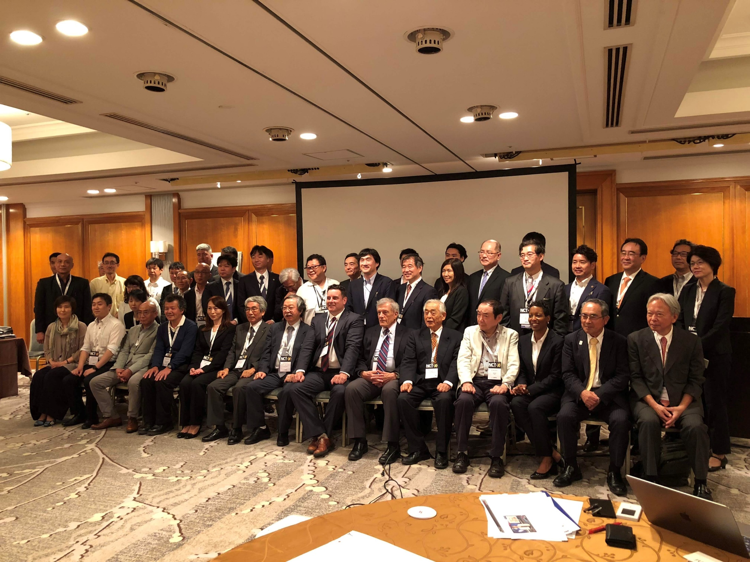
Exercise Types
Tabletop Exercises
- Discussion Based
- Enhanced TTX
- Virtual
Functional Exercise
Full-Scale Exercise

Slide 5
The Tabletop Exercise
Informal and Stress-free Environment
Clear and Achievable Objectives (Roles & Responsibilities, Procedures, Policies)
Guided by Facilitator(s) and Evaluator(s)
Discuss and Solve Problems as a Group
Scalable (Operations, Communications, Leadership)
Virtual TTX's Achievable Based on Technology

Slide 6
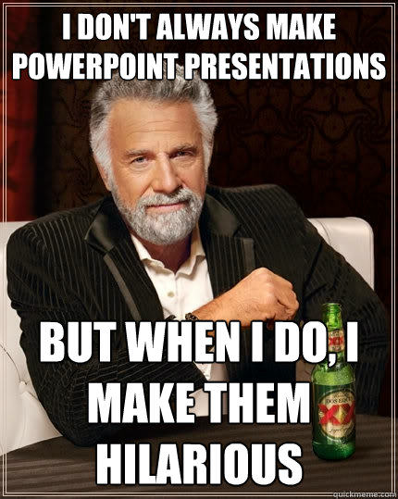


A Missed Opportunity

Slide 7
Why is it a Missed Opportunity?
Not Defining Clear and Achievable Objectives
Inviting the Wrong Audience (Based on Objectives)
Not Creating an Engaging Storyline the Involves Everyone
Not Making it Visually Appealing – Get Creative

Slide 8
Why is it a Missed Opportunity?
Not Having an Evaluation Criteria
Too Challenging or Not Enough – The Balance
Ineffective Pre-Read Material – They Never Read It
Forward Thinking– What’s the Exercise Strategy?

Slide 9
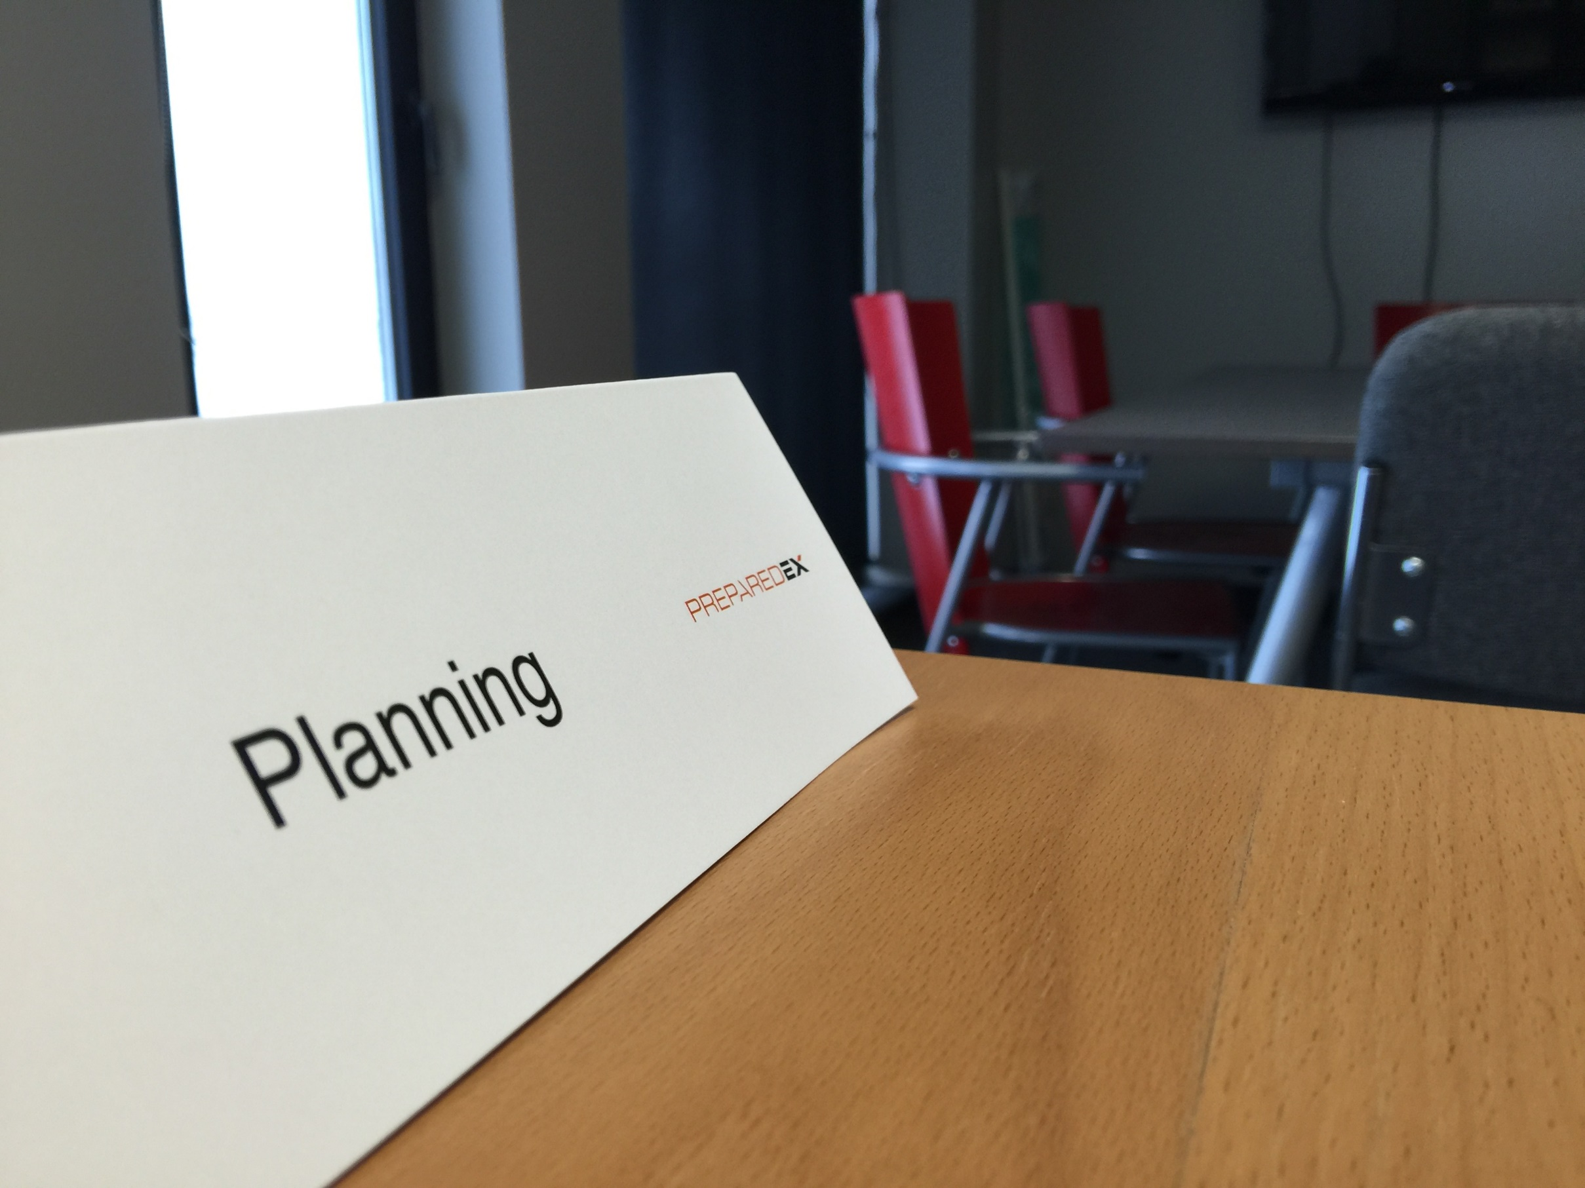

Advantages
5 Steps to Creating and Delivering Effective
Tabletop Exercises
Rob Burton
Doesn’t require too much effort with regards to logistics, and can be delivered in almost any setting
An effective way to review plans, procedures, and company policies
An effective way to familiarize team members with their roles and responsibilities and start to build trust

Slide 10

Advantages
Disadvantages
5 Steps to Creating and Delivering Effective
Tabletop Exercises
Rob Burton
3. An effective way to familiarize team members with their roles and responsibilities
Not as realistic as a functional exercise where systems and processes are usually utilized during exercise play
Provides a lower-level assessment of how the organization may perform during a real event
Often doesn’t represent all the chaos and noise that is associated with a crisis

Slide 11
5 Steps to Creating and Delivering Effective tabletop Exercises
1. Initial Preparation
2. Exercise and Scenario Design
3. Final Exercise Preparation
5. Post Exercise Activities
4. Delivery and Evaluation

Slide 12
Step 1 - The Initial Preparation
Set Clear Objectives (what are you evaluating? Ensure objectives are achievable)
Select the Type of Exercise (Tabletop or other)
Identify Exercise Participants (Players, Actors etc…)
Identify the Control Team (includes evaluator(s))

Slide 13
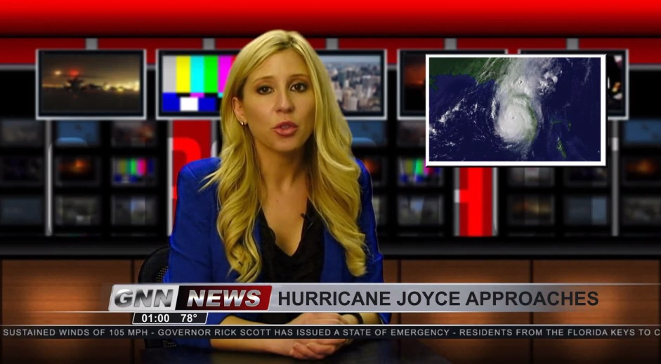
Step 2 – Exercise Design and Scenario Development
Draft the Scenario (a script that is the storyline)
Break out the Storyline in the MSEL (Master Sequence of Events List)
Injects (the event) and Delivery (actual) Time
Recipient(s) (groups or individuals)

Slide 14

Step 3 – Final Exercise Preparation
Ensure Training Location(s) are Fully Equipped and Working
Finalize the Pre-Read Video / Players Handbook and Distribute
Confirm all players know where to be and when
This is also in the player handbook which
sometimes isn’t reviewed by every participant

Slide 15
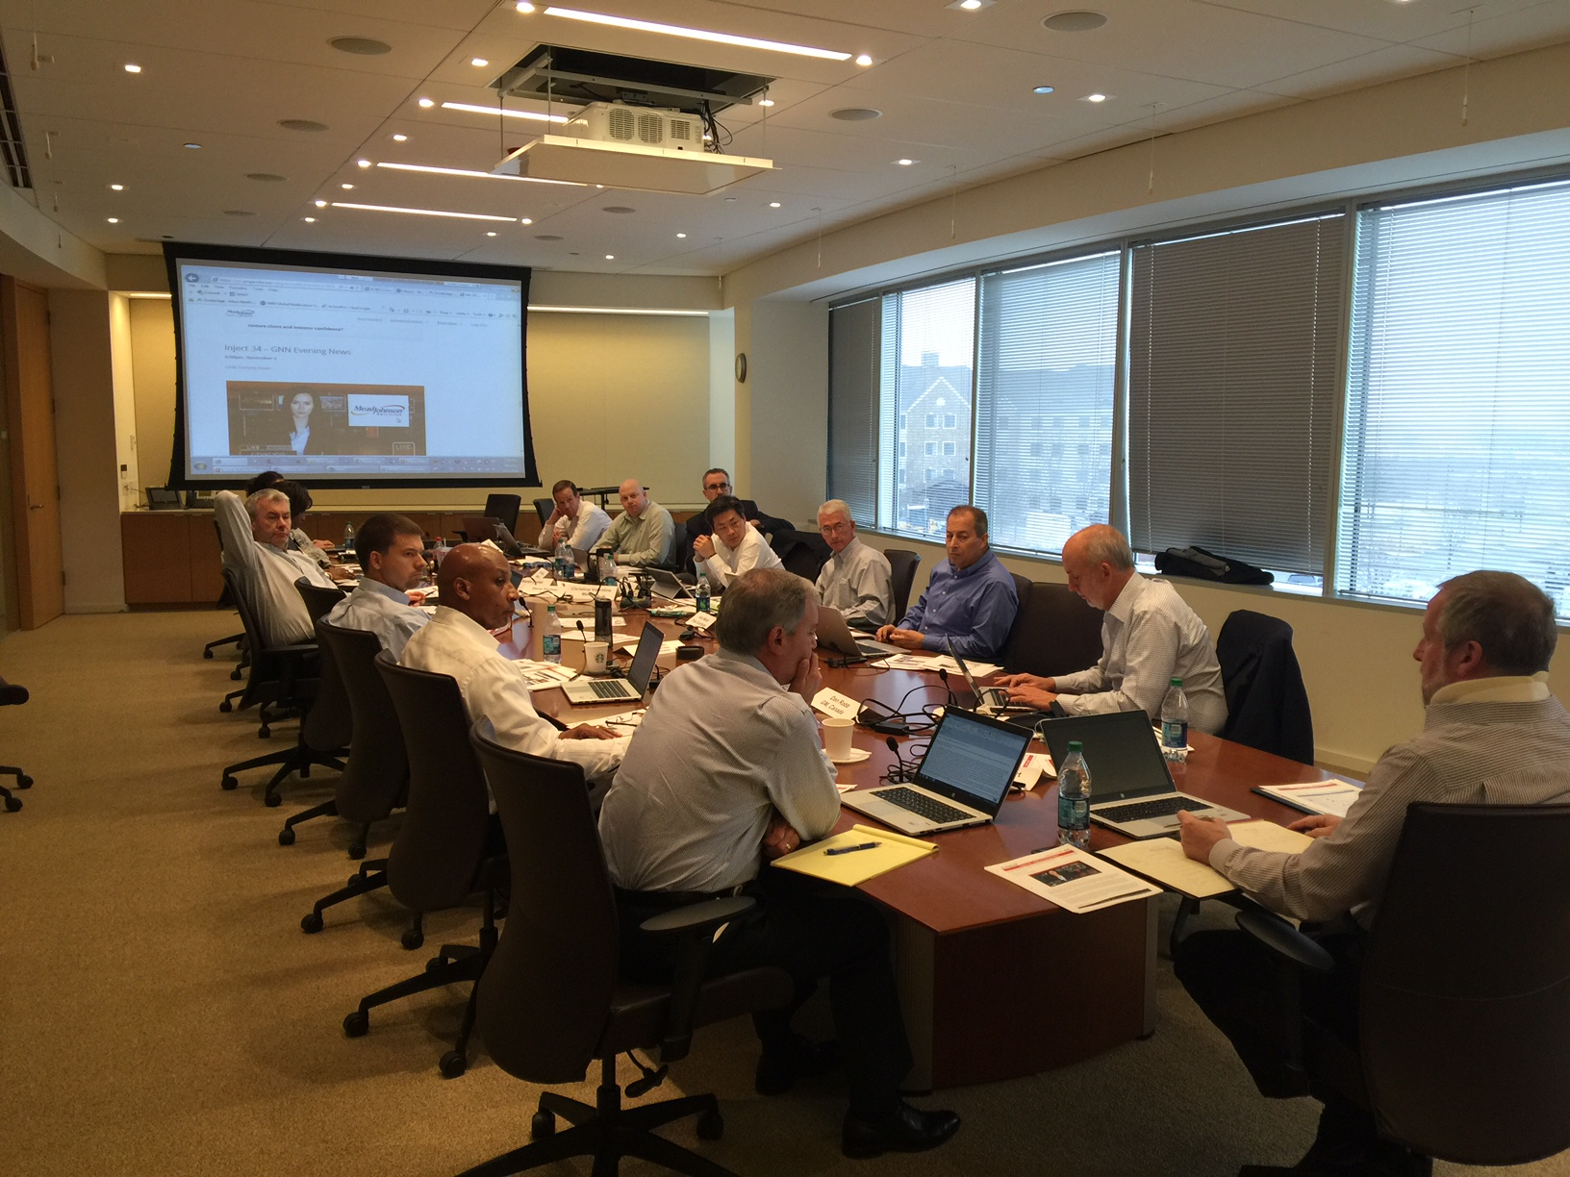
Step 4 – Exercise Delivery and Evaluation
Opening Address (senior person opens, reaffirming the objectives and importance of the event)
Exercise Director remind the participants of the agenda and describes the process (Input – Action - Output)
Issues Board (a board used to document gaps that are raised during the session)

Slide 16

Step 5 – Post Exercise Activities
Gather all Information (team responses, issues board, evaluator data, feedback form)
Conduct the AAC (After Action Conference) This is a meeting is held no more than two weeks after the exercise to review issues as well as accomplishments.
Complete an AAR After Action Report

Slide 17
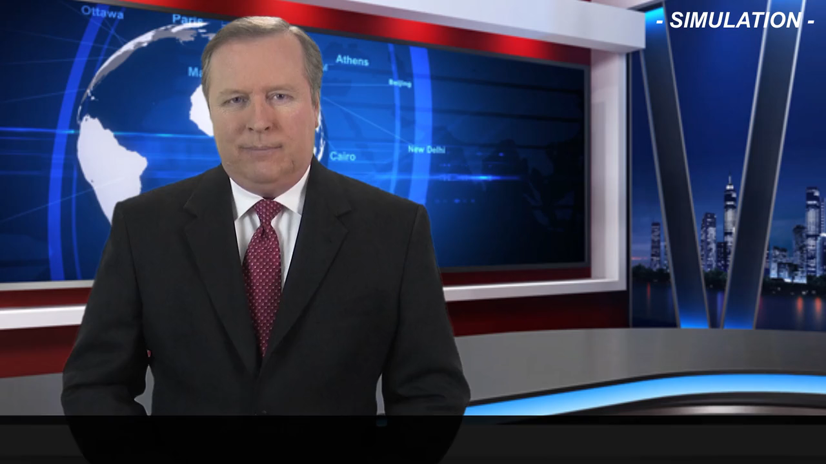
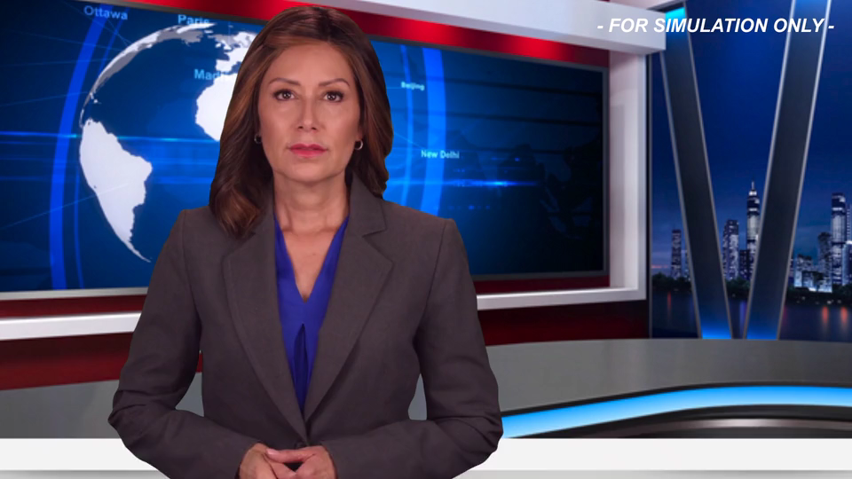
Simulated Multi-Media

Slide 18


Slide 19

operation cyber storm
a simulation exercise

Slide 20

Company background (handout)
Company: Global Petroleum of Wisconsin
870 Employees (3 Operating Shifts)
On Lake Michigan 10 Miles North of Milwaukee
Trained Emergency Response Team and Own Fire Response Capabilities
Corporate Crisis Team
No Joint Exercises with Corporate
Safety and Fire Drills Conducted Monthly
Fire Department Visit Annually
Never Conducted a Full-Scale Exercise
Chlorine, Hydrochloric Acid and Ammonia with Quantity Levels Unknown
Integrated systems (like Colonial Pipeline)

Slide 21
Company roles and game ground rules
Role Playing:
Crisis Leader (GM)
Communications
Legal
HSSE (Health, Safety, Security & Environment)
HR
Operations
Maintenance
Engineering
I.T.
Crisis Coordinator
Rules:
Work together as if you're part of Global Petroleum of Wisconsin
Use the questions to help with your responses
Be ready to brief back
Have fun
Exercise Objectives:
Validate emergency and continuity plans
Validate Global Petroleum's leadership roles and responsibilities
Validate stakeholder communications and relationships
Continue to build our crisis response muscle memory

Slide 22
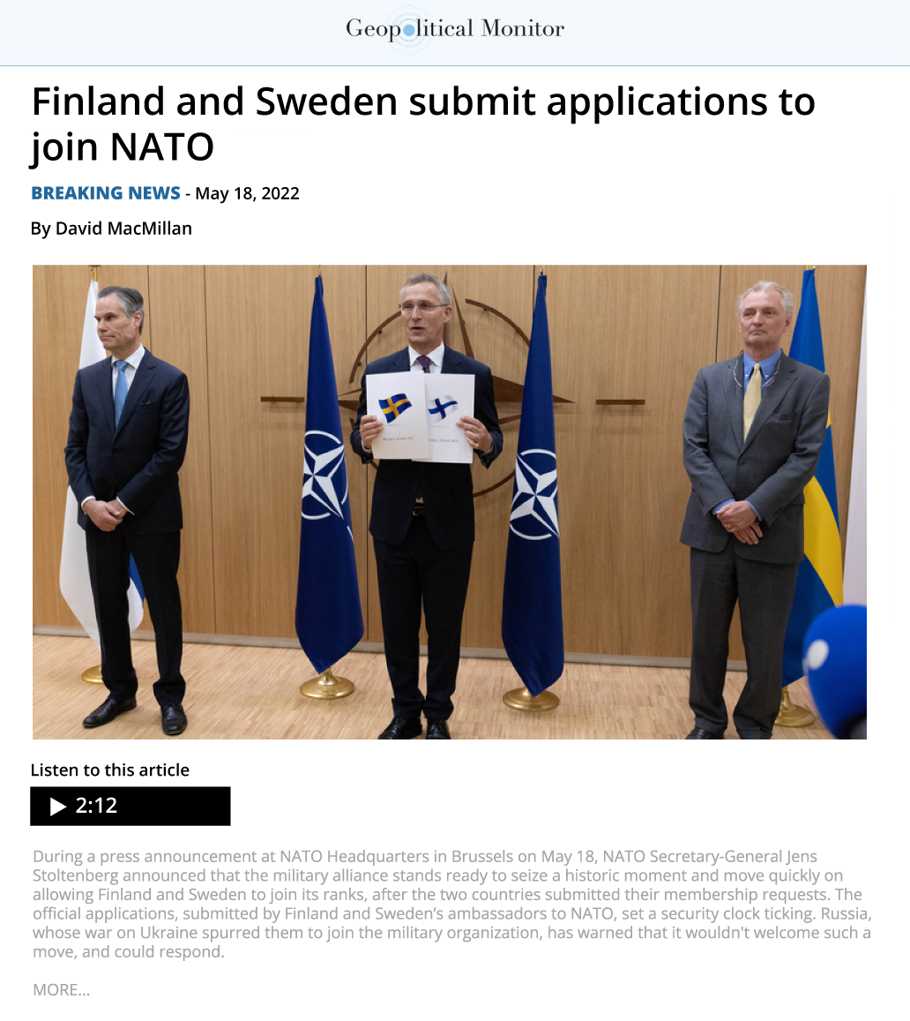

Inject period 1 – May 18 - 21, 2022
background INFORMATION
Adjust Volume Locally For Best Audio Experience

Slide 23
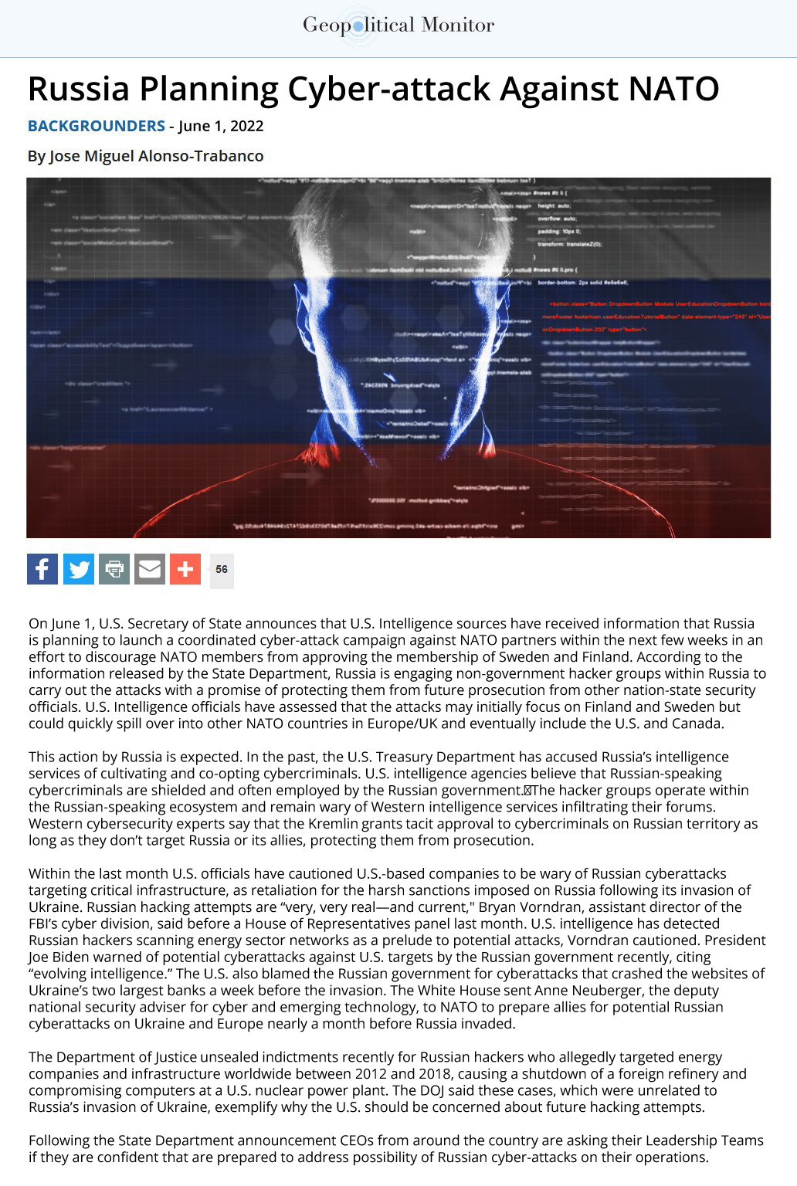
Inject period 2 – June 1st, 2022
On June 1, U.S. Secretary of State announces that U.S. Intelligence sources have received information that Russia is planning to launch a coordinated cyber-attack campaign against NATO partners within the next few weeks in an effort to discourage NATO members from approving the membership of Sweden and Finland. According to the information released by the State Department, Russia is engaging non-government hacker groups within Russia to carry out the attacks with a promise of protecting them from future prosecution from other nation-state security officials. U.S. Intelligence officials have assessed that the attacks may initially focus on Finland and Sweden but could quickly spill over into other NATO countries in Europe/UK and eventually include the U.S. and Canada.
This action by Russia is expected. In the past, the U.S. Treasury Department has accused Russia’s intelligence services of cultivating and co-opting cybercriminals. U.S. intelligence agencies believe that Russian-speaking cybercriminals are shielded and often employed by the Russian government. The hacker groups operate within the Russian-speaking ecosystem and remain wary of Western intelligence services infiltrating their forums. Western cybersecurity experts say that the Kremlin grants tacit approval to cybercriminals on Russian territory as long as they don’t target Russia or its allies, protecting them from prosecution.
Within the last month U.S. officials have cautioned U.S.-based companies to be wary of Russian cyberattacks targeting critical infrastructure, as retaliation for the harsh sanctions imposed on Russia following its invasion of Ukraine. Russian hacking attempts are “very, very real—and current," Bryan Vorndran, assistant director of the FBI’s cyber division, said before a House of Representatives panel last month. U.S. intelligence has detected Russian hackers scanning energy sector networks as a prelude to potential attacks, Vorndran cautioned. President Joe Biden warned of potential cyberattacks against U.S. targets by the Russian government recently, citing “evolving intelligence.” The U.S. also blamed the Russian government for cyberattacks that crashed the websites of Ukraine’s two largest banks a week before the invasion. The White House sent Anne Neuberger, the deputy national security adviser for cyber and emerging technology, to NATO to prepare allies for potential Russian cyberattacks on Ukraine and Europe nearly a month before Russia invaded.
The Department of Justice unsealed indictments recently for Russian hackers who allegedly targeted energy companies and infrastructure worldwide between 2012 and 2018, causing a shutdown of a foreign refinery and compromising computers at a U.S. nuclear power plant. The DOJ said these cases, which were unrelated to Russia’s invasion of Ukraine, exemplify why the U.S. should be concerned about future hacking attempts.
Following the State Department announcement CEOs from around the country are asking their Leadership Teams if they are confident that are prepared to address the possibility of Russian cyber-attacks on their operations.

Slide 24
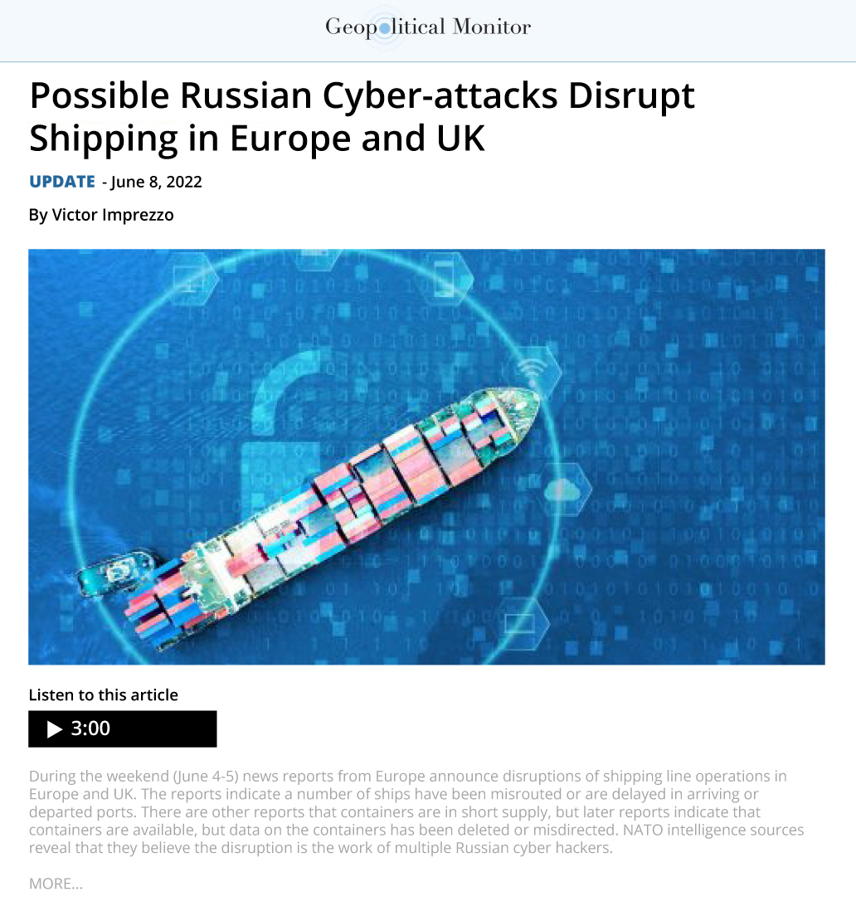
Inject period 3 – June 4 – 8, 2022
Adjust Volume Locally For Best Audio Experience

Slide 25
Inject period 3 – review & Plan
Following the U.S. Intelligence report, CEOs and Board of Directors across the country called in their senior leadership teams and instructed them to provide their respective Boards with a comprehensive strategy to address the potential threat to the company’s current operations. In particular they want the leadership to examine:
Company operations vulnerable to cyber-attacks and actions to minimize disruption of operations
Actions to date
Actions planned
Supply Chain vulnerabilities and plans to adapt to loss of critical material/parts for:
One month, six months or more
Communications with internal and external stakeholders on potential threats and plans of actions to deal with disruptions.

Slide 26
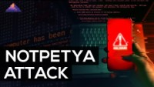
Inject period 3
Breakout into Groups
Choose a Team Name (get creative)
Select Roles (don’t worry about experience)
Discuss Questions
Return with a Brief (30 Minutes)
Breakout Discussion Questions:
If outages impact Global Petroleum operations, what are the mid-to-long-term potential issues?
What and when would you tell your stakeholders? Who are your stakeholder groups?
How would a cyber-attack, like the NotPetya attack on Maersk shipping in 2017, affect today’s supply chain, if it also included simultaneous attacks on 3-4 of the other large shipping lines and ports?
What other questions would you be considering at this time?
Adjust Volume Locally For Best Audio Experience

Slide 27
endex
Document Issues
Make Changes to Plans
Validate Changes (Lessons-to-be-Learned)
Schedule Next Exercise (Advance to Functional and Full-Scale)
Thank you!

Slide 28

CONTACT US!
WE’RE SOCIAL
+1.401.217.4496
ROB.burton@preparedex.COM
@robburton14

